Slide 1
Animal Detection in the Wild Using Computer Vision and AI By Jerry Akom 12th May 2025
CIS 730

Slide 2
Problem Statement
Challenges in Animal Classification:
While pre-trained CNNs like ResNet50, MobileNetV2, and EfficientNetB3 offer solutions, there is a lack of clarity on which models best balance accuracy and efficiency for multi-class classification tasks involving wild animals.
Proposed Solution:
To use transfer learning with pretrained CNNs to classify wild animal images accurately and efficiently.

Slide 3
Objectives
Apply transfer learning using three CNN architectures (MobileNetV2, EfficientNetB3, ResNet50)
Evaluate performance using metrics such as accuracy, precision, recall, F1-score, and parameter count
Determine the trade-offs between model complexity and prediction performance
Identify the most efficient and reliable model for wildlife classification

Slide 4
Methodology Overview
This project followed a structured methodology inspired by Chollet’s guide to transfer learning and fine-tuning. Initially, the Animal Image Dataset (AID), containing over 5,000 labeled images across 90 animal classes, was preprocessed. This involved resizing, normalization, and train-validation-test splitting (70/15/15). Data augmentation techniques were employed for improved generalization. Three pre-trained CNN models—MobileNetV2, ResNet50, and EfficientNetB3—were fine-tuned using Keras with ImageNet weights. Custom classification heads replaced the original top layers, and transfer learning was implemented in two phases: frozen base training, followed by selective unfreezing. Models were trained with the Adam optimizer, monitored by early stopping based on validation loss. Performance was evaluated using classification metrics (accuracy, precision, recall, F1-score) and confusion matrices.

Slide 5
1. Data Collection and Transformation
This project utilized the Animal Image Dataset (AID) from Kaggle, which includes approximately 5,400 images across 90 animal classes. Each class had around 60 images, presenting a diverse and fine-grained dataset for evaluating classification models. However, this diversity also introduced classification complexity due to visual similarities between certain species.The first step in the transformation process was resizing images to match model input dimensions: 224×224 pixels for MobileNetV2 and ResNet50, and 300×300 pixels for EfficientNetB3. Resizing ensured compatibility and reduced memory usage during training. All pixel values were normalized to a [0,1] range, and images were converted to RGB format to align with ImageNet pretraining standards. Each image was processed using model-specific preprocessing functions, enabling accurate interpretation during training.The dataset was split into 70% training, 15% validation, and 15% test sets. This stratification ensured uniform class distribution across subsets, improving the reliability of performance evaluation.
The training set enabled learning, the validation set guided hyperparameter tuning, and the test set assessed final model generalization.To increase robustness and reduce overfitting, data augmentation techniques were applied. These included flipping, rotation, zooming, shifting, and brightness adjustments. Implemented using TensorFlow’s ImageDataGenerator, augmentations were applied dynamically during training. Despite expectations, these augmentations did not yield significant performance gains, suggesting the dataset’s natural variation was sufficient or that augmentations introduced redundant information.Labels were one-hot encoded to support multi-class classification. Images were stored in a directory structure compatible with flow_from_directory, simplifying loading and labeling. This organization facilitated efficient training using Keras pipelines.All preprocessing was conducted in Python using libraries like TensorFlow, NumPy, and OpenCV. The entire workflow was executed on Google Colab with access to a T4 GPU, enabling seamless handling of data transformation and training tasks.

Slide 6
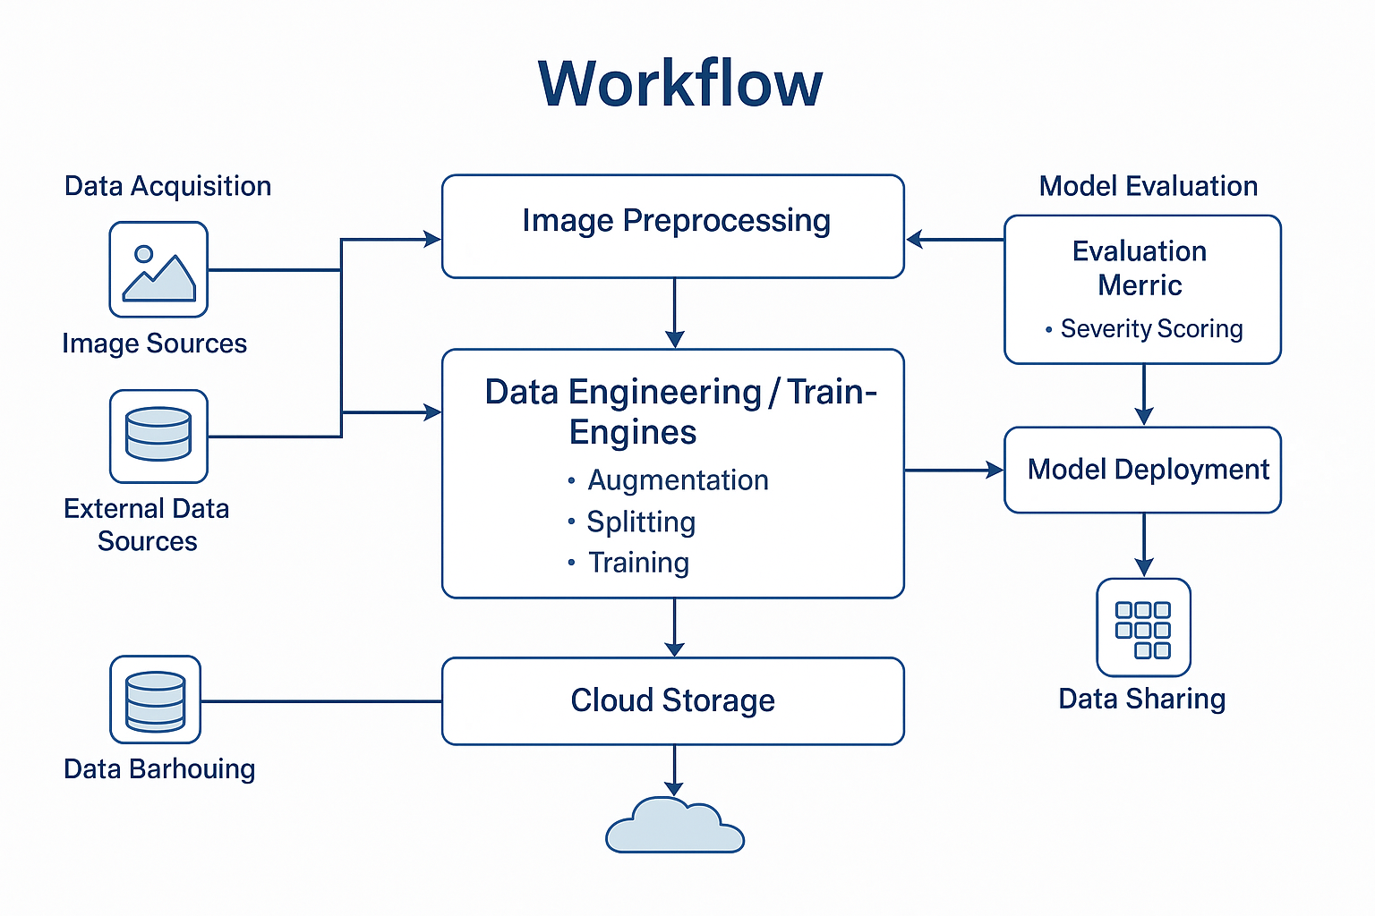
Fig 1. Workflow of image processing

Slide 7
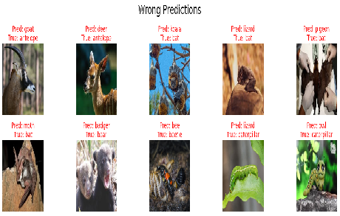
Fig 2. Examples of Misclassified images that helped identify limitations in model generalization, especially for visually similar species.

Slide 8
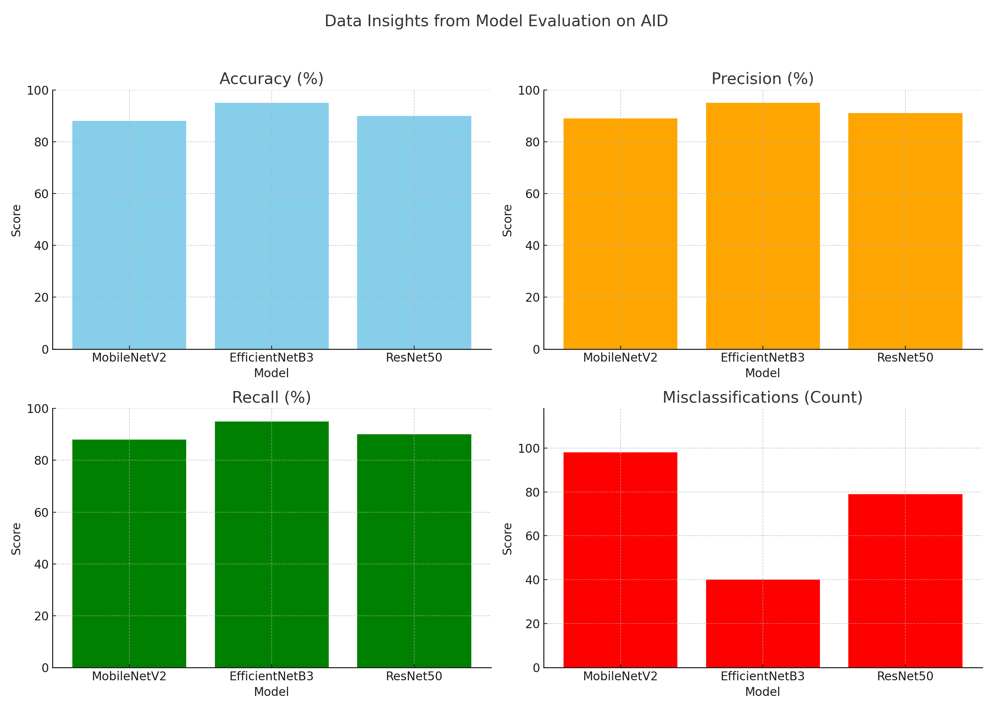
Data Insights
Key Features:
EfficientNetB3 stands out with the highest performance across all evaluation metrics—95% accuracy, precision, and recall.
ResNet50 delivers a balanced performance, achieving strong accuracy but its large size and higher misclassification rate indicate reduced efficiency compared to EfficientNetB3.
Data Challenges:
Although each animal class had a roughly equal number of images, visual similarity between species—such as deer vs. goats or rats vs. squirrels—led to frequent misclassifications. This fine-grained overlap made it difficult for models to distinguish subtle differences, especially in low-quality or ambiguous images.
With only about 60 images per class, the dataset offered limited variability, which restricted the model's ability to generalize. While data augmentation was applied to compensate, it did not significantly improve accuracy, highlighting the need for more diverse and representative training data.
Data Insights from Model Evaluation on Test Sets.

Slide 9
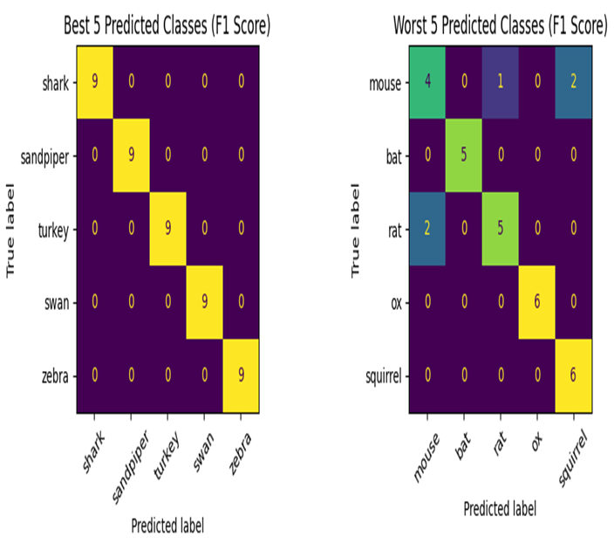
Model Development
Models Used:
MobileNetV2 – Lightweight and efficient, ideal for mobile or resource-constrained environments.
EfficientNetB3 – Optimized using compound scaling; delivered best overall performance.
ResNet50 – Deep residual network with strong feature learning capabilities.
Training Details:
Transfer learning approach with ImageNet-pretrained weights.
Initial training of custom classification head, followed by fine-tuning of top layers.
Performance Metrics:
EfficientNetB3: 95% accuracy, 40 misclassificationsResNet50: 90% accuracy, 79 misclassifications
MobileNetV2: 88% accuracy, 98 misclassifications

Slide 10
Model Performance Comparison
EfficientNetB3:
Accuracy: 95%
F1-Score: High.
ResNet50:
Accuracy: 90%
F1-Score: High.
Key Insight: EfficientNetB3’s had superior ability to distinguish between fine-grained animal categories, likely due to its compound scaling and squeeze-and-excitation blocks.

Slide 11
Challenges and Limitations
Visually similar species often led to frequent model misclassifications.
Data augmentation did not significantly improve model performance results.
Limited images per class reduced overall generalization effectiveness.
High model complexity increased training time and computational resource demands.

Slide 12
Recommendations for Future Work
Explore additional CNNs for >95% accuracy
Test models on other fine-grained classification tasks
Use larger or domain-specific datasets
Deploy models in real-world monitoring systems

Slide 13

Q&A
Questions or feedback?
Thank you

